Slide 1
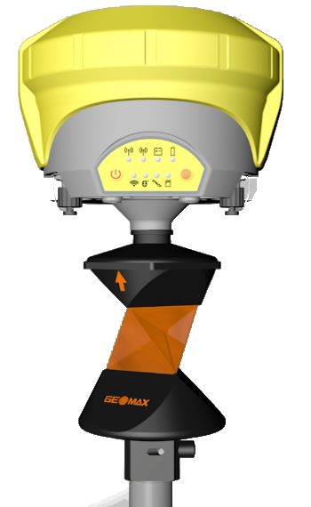

X•Pole
One pole, Two systems

Slide 2






X•Pole
When X-PAD GNSS & TPS Robotic modules are active then the X•Pole is available
X•Pole solution consists of :
GeoMax Zoom90 robotic total station
360° prosm with 5/8” screw (GRZ122)
GeoMax Zenith15/25/35 GNSS receiver
X•PAD software version 3.0 (or higher)

Slide 3
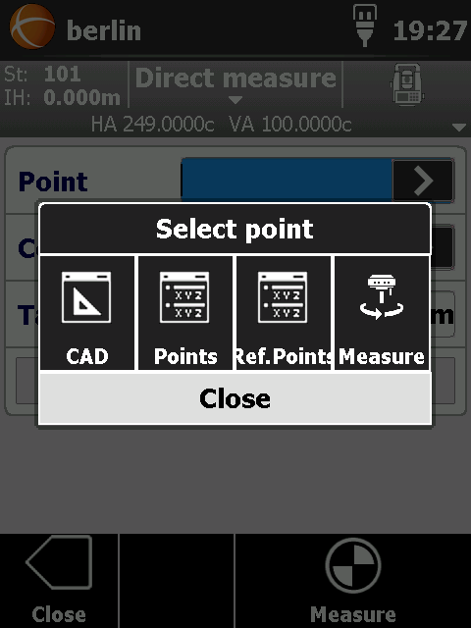
X•Pole – Free Station
To calculate the TPS position you need some known points
In Free station mode you can measure your points with GNSS receiver and immediately measure the same with TPS (you need to define a coordinate system)
TPS position is calculated and oriented in the GNSS reference system

Slide 4
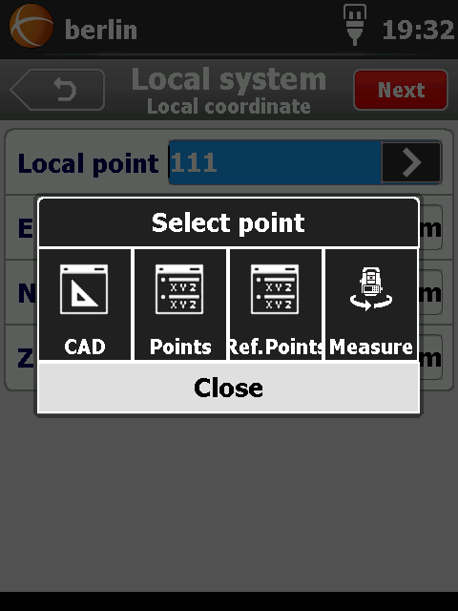
X•Pole – GNSS site calibr.
You are working with TPS (on a local system) and decide to start to use the GNSS
With GNSS site calibration you need some known points
In GNSS site calibration mode you can measure your “known” points with TPS and immediately with the receiver

Slide 5
X•Pole – Search by GNSS
If prism has been lost & receiver is fixed
Station rotate automatically toward the prism (because his position is known) and lock it

Slide 6
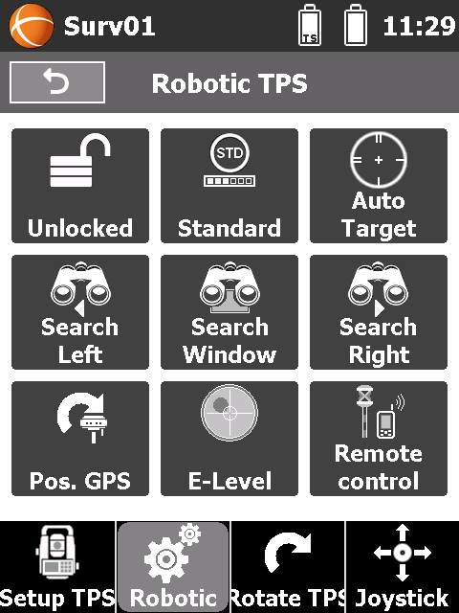
X•Pole – Search by GNSS

Slide 7
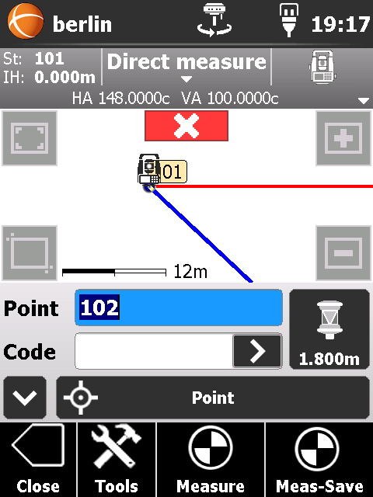
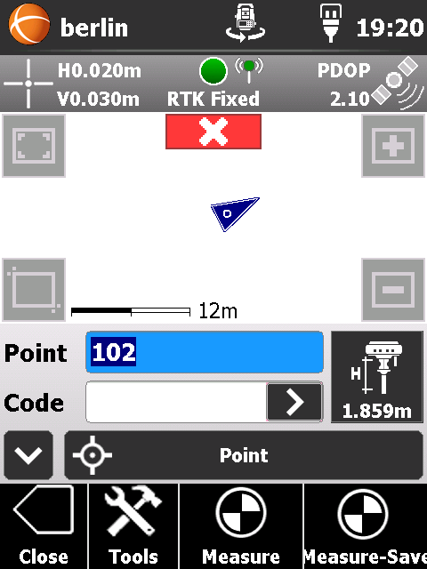
X•Pole – Mixed survey

